Slide 1
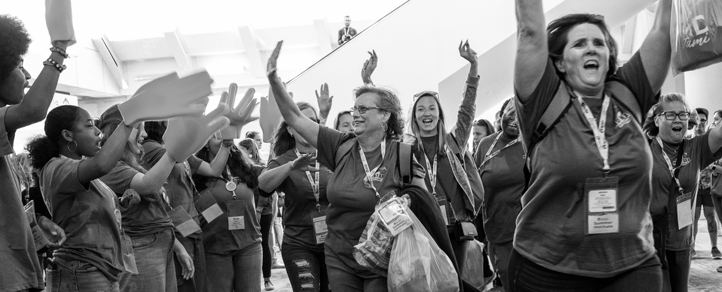




AVID Impact
(School/District Name)
Contact Information:
Email address
Mobile: (xxx) xxx-xxxx

Slide 2



We share the AVID mission.
To close the opportunity gap by preparing all students for college and career readiness and success in a global society.​
Change logo above and include your school motto/vision/mission statement here.
AVID Impact
Notes:
Thank you so much for having us here today. We are really excited to talk with you about AVID because we are aligned in our missions.

Slide 3



School/District Background
Our AVID Story
Why did we need AVID?
When did AVID implementation begin in the district and/or at this campus?
How did implementation begin?
Who are our students?
What are we hoping to
accomplish, and how will
we know we have
accomplished it?
AVID Impact
Notes:
What grade levels and how many AVID Elective classes (Secondary)? Include demographics and other characteristics for examples. Use the following slides as starting points for the data story you want to share with stakeholders.

Slide 4


Outcomes/Data
Examples:
Senior Data
A–G Eligibility (California-specific)
Attendance
Examples:
Survey Data
Whatever data used to determine return on investment
AVID Impact

Slide 5




District Snapshot
Number of AVID Secondary Schools
Number of AVID Elective/Excel sections
Number of secondary students served (AVID Elective and AVID Excel)
% of AVID-trained staff (teachers, counselors, administrators)
Number of AVID Elementary Schools
Number of elementary students served
% of AVID-trained staff (teachers, counselors, administrators)
AVID Impact

Slide 6


Rigorous Academic Preparedness
Number of middle school students enrolled in Honors, Pre-AP® and/or high school credit-bearing courses
    AVID Students/All Students
Number of high school students enrolled in at least
one AP, IB, AICE, dual enrollment, CTE, or PLTW course
    AVID Students/All Students
Number of AVID students taking at least one AP, IB, AICE, or PLTW exam
    AVID Students/All Students
FAFSA Completion Rates
    AVID Students/Non-AVID Students
AVID Impact

Slide 7
Secondary Attendance Data
Attendance Rate | Middle School | High School
AVID Elective students’ average attendance rate | % | %
AVID Excel students’ average attendance rate | % | %
All other students’ average attendance rate | % | %
AVID Impact

Slide 8
Elementary Attendance Data
Attendance Rate | Non-AVID Classrooms | AVID Classrooms
Students’ average attendance rate | % | %
AVID Impact

Slide 9
High School Graduation Rates
AVID Students/Non-AVID Students
AVID Impact

Slide 10

Scholarship Dollars
Previous School Year
Current School Year
AVID Impact

Slide 11


Cultivating a College & Career Readiness Culture
% Applying to 4-Year
  AVID Students/Non-AVID Students
% Planning to attend 4-year
  AVID Students/Non-AVID Students
% Planning to attend 2-year
  AVID Students/Non-AVID Students
Students graduating with a
college degree, certification, or
entering military
  AVID Students/Non-AVID Students
AVID Impact

Slide 12




THANK YOU!
Contact Information:
Email address
Mobile: (xxx) xxx-xxxx

